Slide 1

App Market Trends
A Deep Dive into Google Play Store Dataset

Slide 2

Introduction
The Google Play Store is packed with millions of apps—everything from games to tools that make life easier. But have you ever wondered what makes some apps super popular while others barely get noticed?
In this project, we dig into real app data to find out what’s trending, which categories are winning, and how ratings and installs really work. By cleaning up the messy data and exploring it step-by-step, we’ll uncover cool insights that can help app makers and users understand what’s really going on behind the scenes.

Slide 3
Objective
Dive deep into the app data We want to really understand what’s going on — from ratings to installs and everything in between. This means exploring the data carefully to spot trends and patterns that aren’t obvious at first glance.
Clean up the messy parts Real-world data can be tricky — missing values, duplicates, weird entries. So, we make sure to tidy everything up so our results are reliable and meaningful.
Visualize to reveal the story Numbers are great, but pictures tell the story better. Using charts and graphs, we highlight which app categories are winning, how users rate apps, and how popular different apps really are.
Find useful insights Beyond just numbers, we want to pull out the key takeaways that can help app creators and marketers make smarter decisions — like what categories to focus on or how pricing might affect installs.
Share clear and simple results Finally, we want to present all this info in a way that’s easy to understand, so anyone — from a developer to a casual user — can grasp the key points and benefits.

Slide 4
Tools and Technology
We used a mix of powerful and beginner-friendly tools to make this analysis smooth and insightful:
🐍 Python Our main language for data handling, analysis, and visualization.
📊 Pandas & NumPy For data manipulation, numerical operations, and cleaning messy datasets.
📈 Matplotlib & Seaborn To create beautiful charts and graphs that help us understand trends easily.
🧼 Jupyter Notebook / Colab Used for writing and running code step-by-step with visual outputs.
🧠 Basic Statistical Techniques To understand distributions, averages, and variations in the data.

Slide 5
Dataset
We used a publicly available dataset from Kaggle containing app-related information from the Google Play Store.
Key Features of the Dataset:
Total Records: 10841 apps
Columns include:
App. . Last Updated
Category. . Current Ver
Rating . Android Ver
Reviews
Size
Installs
Price
Genre
Last Updated
Type

Slide 6
Data Cleaning
Why Clean the Data?
Real-world datasets aren’t perfect. They often have missing values, weird characters, inconsistent formats, or even duplicate entries. Before we jump into analysis, we need to clean things up.
What We Did:
Removed unnecessary columns Dropped unnamed or empty columns that weren’t adding value.
Handled missing values Replaced or removed rows with missing data like "Size" or "Rating".

Slide 7
Data Cleaning
Cleaned numerical columns Fixed "Installs", "Price", and "Reviews" by removing symbols like +, ,, and $ to convert them into proper numbers.
Standardized size column Converted app sizes from "M", "k", and "Varies with device" into a uniform numeric format.
Fixed data types Converted date columns into proper datetime format, and string-based numbers into integers or floats.
Removed duplicates Dropped repeated app entries keeping only the first clean record.
Result:
After cleaning, the dataset was structured, consistent, and ready for meaningful analysis!

Slide 8
Univariate Analysis: Understanding Individual Features
Goal: Analyze each column separately to understand its distribution and characteristics.
Numerical Features (e.g., Rating, Installs, Reviews, Price)
Most apps are free
Ratings are right-skewed, clustering around 4.1–4.5
Very few apps have >1M installs
Categorical Features (e.g., Category, Type, Content Rating)
Top Categories: Family, Tools, Game
App Type: Majority are Free
Content Rating: Dominated by “Everyone”
Helps identify trends, outliers & common patterns in app data.

Slide 9
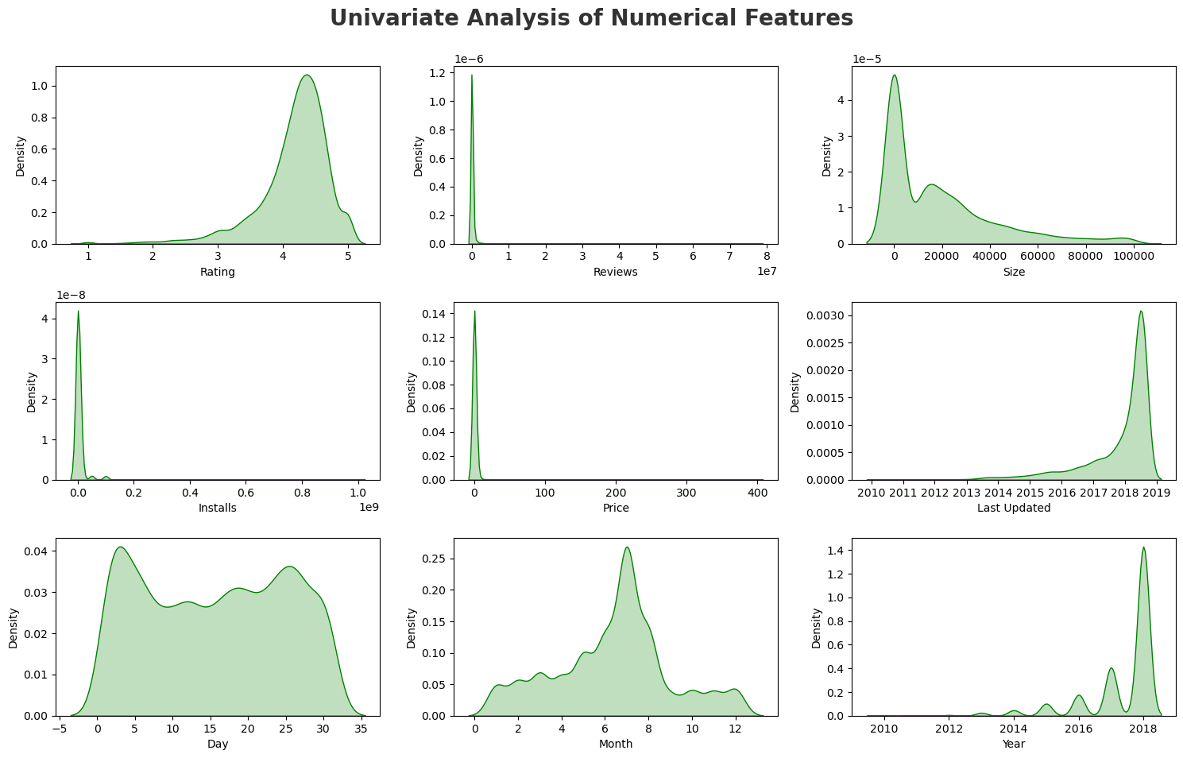
Univariate Analysis: Understanding Individual Features

Slide 10
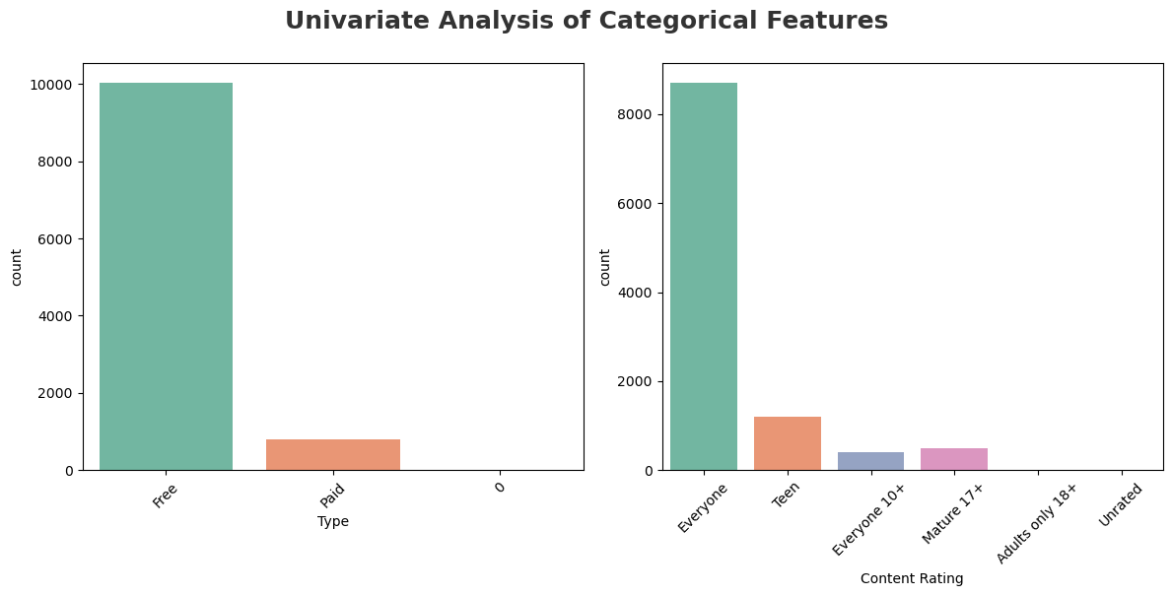
Univariate Analysis: Understanding Individual Features

Slide 11
Conclusions
Rating and Year is left skewed while Reviews,Size,Installs and Price are right skewed
-Which is the most popular app category?
Ans -The most popular app category is 'FAMILY' with 1832 apps.
-Observations(Using Pie Chart)
1. There are more kinds of apps in playstore which are under category of family, games & tools
2. Beauty,comics,arts and weather kinds of apps are very less in playstore

Slide 12
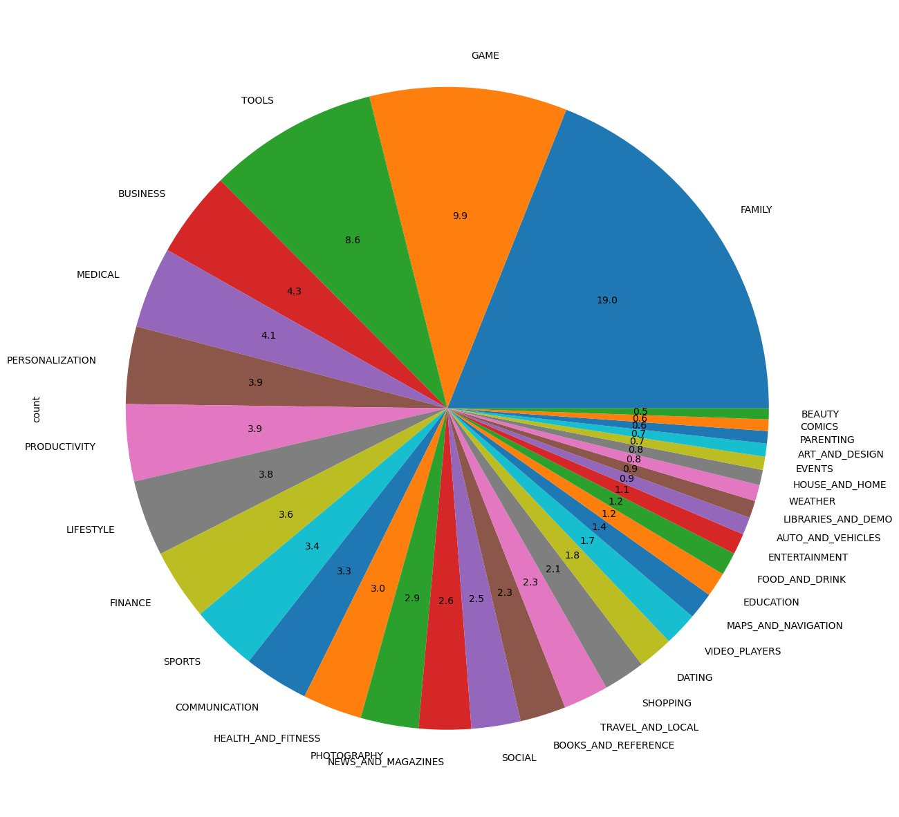
Conclusions

Slide 13
Conclusions
Insights(Using Bar plot)
1. Family category has the most number of apps with 18% of apps belonging to it, followed by Games category which has 11% of the apps.
2. Least number of apps belong to the Beauty category with less than 1% of the total apps belonging to it.
-Which Category has largest number of installations?
The category with the highest number of installations is 'GAME' with 13,878,924,415 installs.
-How many apps are there on Google Play Store which get 5 ratings?
Total number of apps with 5-star rating: 271

Slide 14
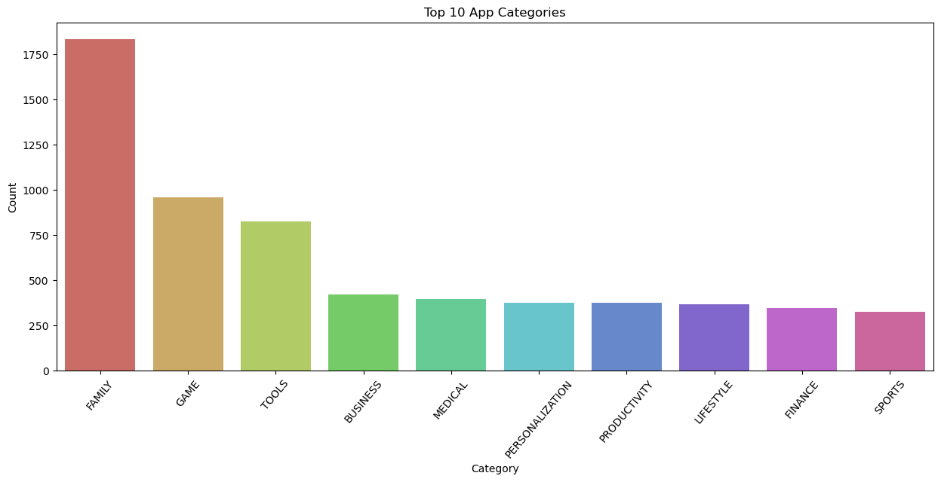
Conclusions

Slide 15
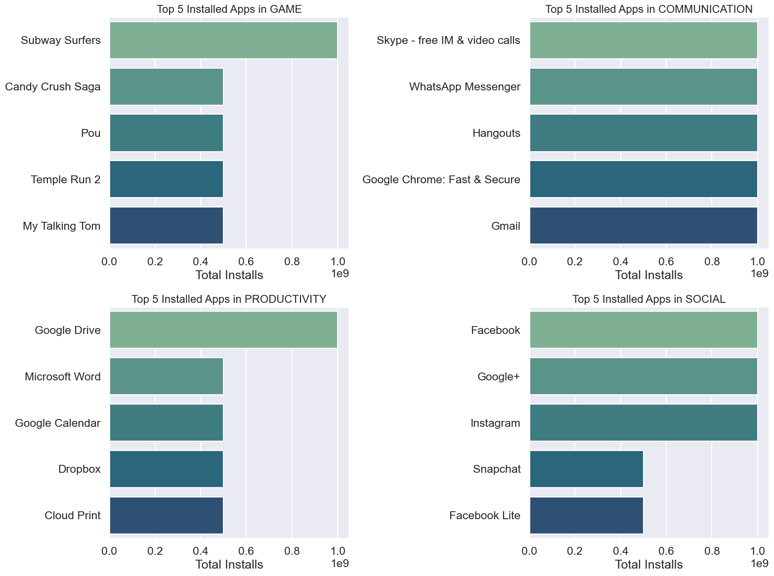
Conclusions

